Slide 1

HBase and Hive at StumbleUpon
Jean-Daniel Cryans
DB Engineer at StumbleUpon
HBase Committer
@jdcryans, jdcryans@apache.org

Slide 2

Highlights
Why Hive and HBase?
  HBase refresher
  Hive refresher
  Integration
Hive @ StumbleUpon
  Data flows
  Use cases

Slide 3

HBase Refresher
Apache HBase in a few words:
  “HBase is an open-source, distributed, versioned, column-oriented store modeled after Google's Bigtable”
Used for:
  Powering websites/products, such as StumbleUpon and Facebook’s Messages
  Storing data that’s used as a sink or a source to analytical jobs (usually MapReduce)
Main features:
  Horizontal scalability
  Machine failure tolerance
  Row-level atomic operations including compare-and-swap ops like incrementing counters
  Augmented key-value schemas, the user can group columns into families which are configured independently
  Multiple clients like its native Java library, Thrift, and REST
Notes:
Family configurations such as replication scope, compression, caching priority

Slide 4

Hive Refresher
Apache Hive in a few words:
  “A data warehouse infrastructure built on top of Apache Hadoop”
Used for:
  Ad-hoc querying and analyzing large data sets without having to learn MapReduce
Main features:
  SQL-like query language called QL
  Built-in user defined functions (UDFs) to manipulate dates, strings, and other data-mining tools
  Plug-in capabilities for custom mappers, reducers, and UDFs
  Support for different storage types such as plain text, RCFiles, HBase, and others
  Multiple clients like a shell, JDBC, Thrift

Slide 5
Integration
Reasons to use Hive on HBase:
  A lot of data sitting in HBase due to its usage in a real-time environment, but never used for analysis
  Give access to data in HBase usually only queried through MapReduce to people that don’t code (business analysts)
  When needing a more flexible storage solution, so that rows can be updated live by either a Hive job or an application and can be seen immediately to the other
Reasons not to do it:
  Run SQL queries on HBase to answer live user requests (it’s still a MR job)
  Hoping to see interoperability with other SQL analytics systems

Slide 6

Integration
How it works:
  Hive can use tables that already exist in HBase or manage its own ones, but they still all reside in the same HBase instance
Hive table definitions
HBase
Points to an existing table
Manages this table from Hive

Slide 7
Integration
How it works:
  When using an already existing table, defined as EXTERNAL, you can create multiple Hive tables that point to it
Hive table definitions
HBase
Points to some column
Points to other columns, different names

Slide 8
Integration
How it works:
  Columns are mapped however you want, changing names and giving types
Hive table definition
HBase table
persons
people
name STRING
d:fullname
age INT
d:age
siblings MAP<string, string>
d:address
f:
Notes:
a column name was changed, one isn’t used, and a map points to a family

Slide 9
Integration
Drawbacks (that can be fixed with brain juice):
  Binary keys and values (like integers represented on 4 bytes) aren’t supported since Hive prefers string representations, HIVE-1634
  Compound row keys aren’t supported, there’s no way of using multiple parts of a key as different “fields”
  This means that concatenated binary row keys are completely unusable, which is what people often use for HBase
  Filters are done at Hive level instead of being pushed to the region servers
  Partitions aren’t supported

Slide 10

@

Slide 11
Data Flows
Data is being generated all over the place:
  Apache logs
  Application logs
  MySQL clusters
  HBase clusters
We currently use all that data except for the Apache logs (in Hive)

Slide 12
Data Flows
Moving application log files
Transforms format
HDFS
Dumped into
Read nightly
Wild log file
Tail’ed continuously
Parses into HBase format
Inserted into
HBase

Slide 13
Data Flows
Moving MySQL data
Dumped nightly with CSV import
HDFS
MySQL
Tungsten replicator
Parses into HBase format
Inserted into
HBase

Slide 14
Data Flows
Moving HBase data
CopyTable MR job
HBase MR
HBase Prod
Read in parallel
Imported in parallel into
* HBase replication currently only works for a single slave cluster, in our case HBase replicates to a backup cluster.

Slide 15
Use Cases
Front-end engineers
  They need some statistics regarding their latest product
Research engineers
  Ad-hoc queries on user data to validate some assumptions
  Generating statistics about recommendation quality
Business analysts
  Statistics on growth and activity
  Effectiveness of advertiser campaigns
  Users’ behavior VS past activities to determine, for example, why certain groups react better to email communications
  Ad-hoc queries on stumbling behaviors of slices of the user base

Slide 16
Use Cases
Using a simple table in HBase:
CREATE EXTERNAL TABLE blocked_users(
userid INT,
blockee INT,
blocker INT,
created BIGINT)
STORED BY 'org.apache.hadoop.hive.hbase.HBaseStorageHandler’
WITH SERDEPROPERTIES ("hbase.columns.mapping" =
":key,f:blockee,f:blocker,f:created")
TBLPROPERTIES("hbase.table.name" = "m2h_repl-userdb.stumble.blocked_users");
HBase is a special case here, it has a unique row key map with :key
Not all the columns in the table need to be mapped

Slide 17
Use Cases
Using a complicated table in HBase:
CREATE EXTERNAL TABLE ratings_hbase(
userid INT,
created BIGINT,
urlid INT,
rating INT,
topic INT,
modified BIGINT)
STORED BY 'org.apache.hadoop.hive.hbase.HBaseStorageHandler’
WITH SERDEPROPERTIES ("hbase.columns.mapping" =
":key#b@0,:key#b@1,:key#b@2,default:rating#b,default:topic#b,default:modified#b")
TBLPROPERTIES("hbase.table.name" = "ratings_by_userid");
#b means binary, @ means position in composite key (SU-specific hack)

Slide 18
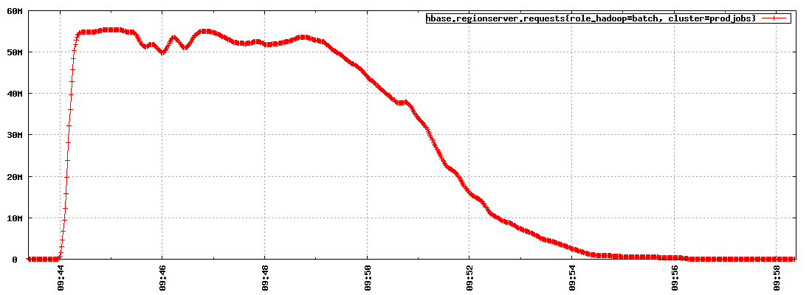
Use Cases
Some metrics:
  Doing a SELECT (*) on the stumbles table (currently 1.2TB after LZO compression) used to take over 2 hours with 20 machines, today it takes 12 minutes with 80 newer machines.

Slide 19
Wrapping up
Hive is a good complement to HBase for ad-hoc querying capabilities without having to write a new MR job each time.
    (All you need to know is SQL)
Even though it enables relational queries, it is not meant for live systems.
      (Not a MySQL replacement)
The Hive/HBase integration is functional but still lacks some features to call it ready.
    (Unless you want to get your hands dirty)

Slide 20
In Conclusion…
?

Slide 21

In Conclusion…
?
?
?

Slide 22
Have a job yet?
We’re hiring!
  Analytics Engineer
  Database Administrator
  Site Reliability Engineer
  Senior Software Engineer
  (and more)
http://www.stumbleupon.com/jobs/

